Slide 1
CS250 – Lab 02 multimeter, schematic grammar, and voltage divider equation
Prof. George Adams
Purdue University

Slide 2
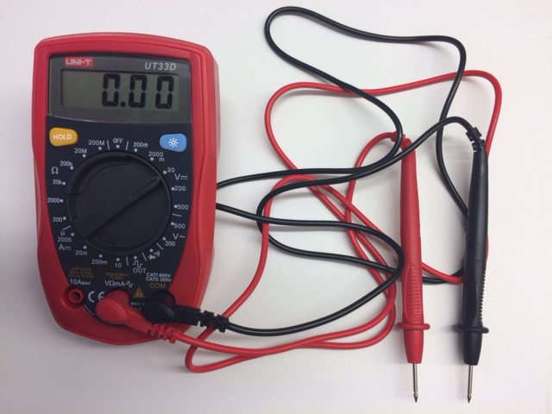
The electrical multimeter
Used to measure resistance and voltage via red and black probes
Here the multimeter selector is set to measure voltages greater than 2000 millivolts (2 volts) and less than 20 volts

Slide 3
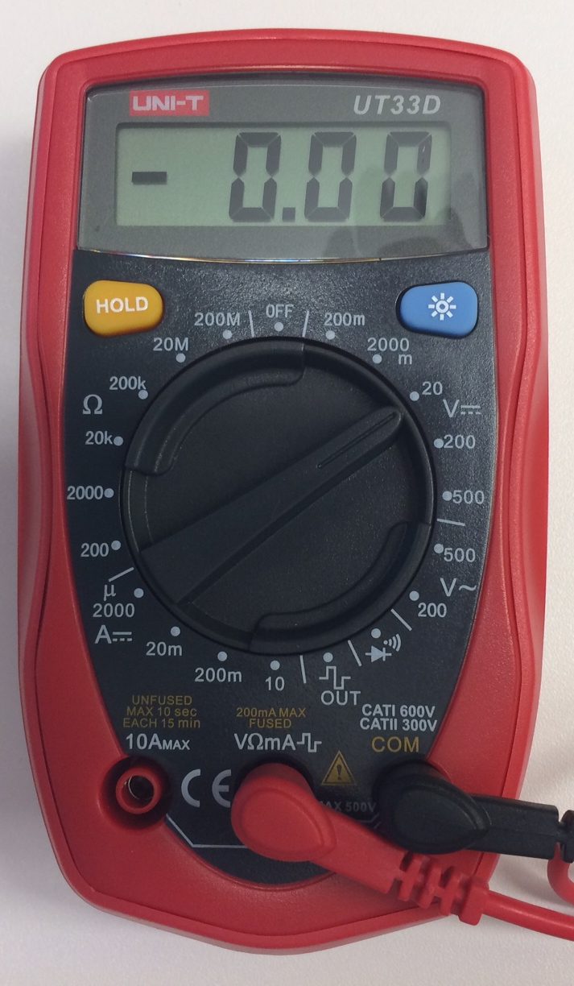
Multimeter close up
Measured voltages can be negative or positive

Slide 4
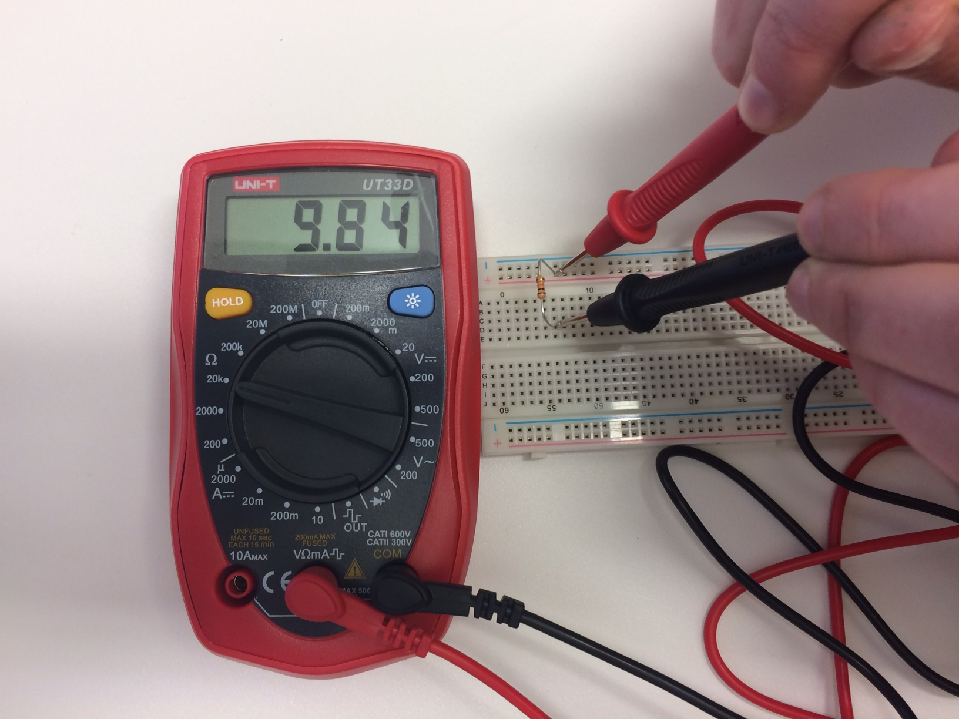
Measuring resistance of 10KΩ resistor
Probes are pressed strongly into tie points to make good contact with resistor leads

Slide 5
Close up of measuring resistance
Probes push firmly against resistor leads
Meter reads 9.84 KΩ = 10 KΩ ± 5% (± 500 Ω)

Slide 6
Measuring a voltage in a circuit
Set selector to desired voltage range (scale)
Place the black probe firmly in a tie point against a device lead or wire that is ground
Place the red probe firmly in a tie point for the circuit node for which voltage is to be measured
Record the meter reading
If meter reads “0.L” this means ”overflow,” that is the value is too large to display within the selected range

Slide 7
Fun voltage measurement; and Last Step
Set voltage scale to its most sensitive, 200 mV, (milli-Volts, or thousandths of a volt)
Tightly grab on to the probe metal ends, one in each hand
The varying reading is the electrical potential at the surface of your fingers
LAST STEP: set the selector to OFF to preseve the multimeter battery

Slide 8
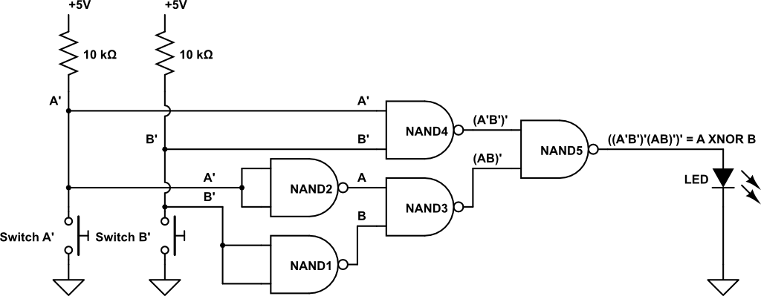
Lab 02 – first logic circuit
Look for the “words” of the schematic, link those words into the “statement of meaning,” see the grammar of abstraction used in the diagram

Slide 9
Look for the “words” of the schematic
Lab 02 asks you to – “build a circuit using multiple two-input NAND gates …”
LOGIC GATES

Slide 10
Look for more “words”
Lab 02 says – “build a circuit using multiple two-input NAND gates to implement … the two-input …”
INPUT

Slide 11
Lab 02 – final words
Lab 02 – “build a circuit using multiple two-input NAND gates to implement … the two-input … XNOR function.”
OUTPUT

Slide 12
See the grammar of the diagram
Flowing from left to right to enhance readability:
input → logic → output
Now see hardware as software
Data (inputs), algorithm (logic), transformed data (output)

Slide 13
Pushbutton switch is a two-valued resistor
Proportional to the value of their resistance in Ohms, resistors impede the flow of electrons
The pushbutton switches in your lab kit have two states: not pushed (normal state) and pushed (active state)
When not pushed there is an air gap inside the switch between the input and output pins of the switch; air has a very high resistance
When pushed, the switch moves a wire with very low resistance so that it connects the input and output pins
Using the multimeter, measure the resistance value of a pushbutton switch for each state
Use these two values in the equation for Output voltage from the following slide to compute the two values for V₂
V, the supply voltage is from a USB port, and so is +5 volts

Slide 14
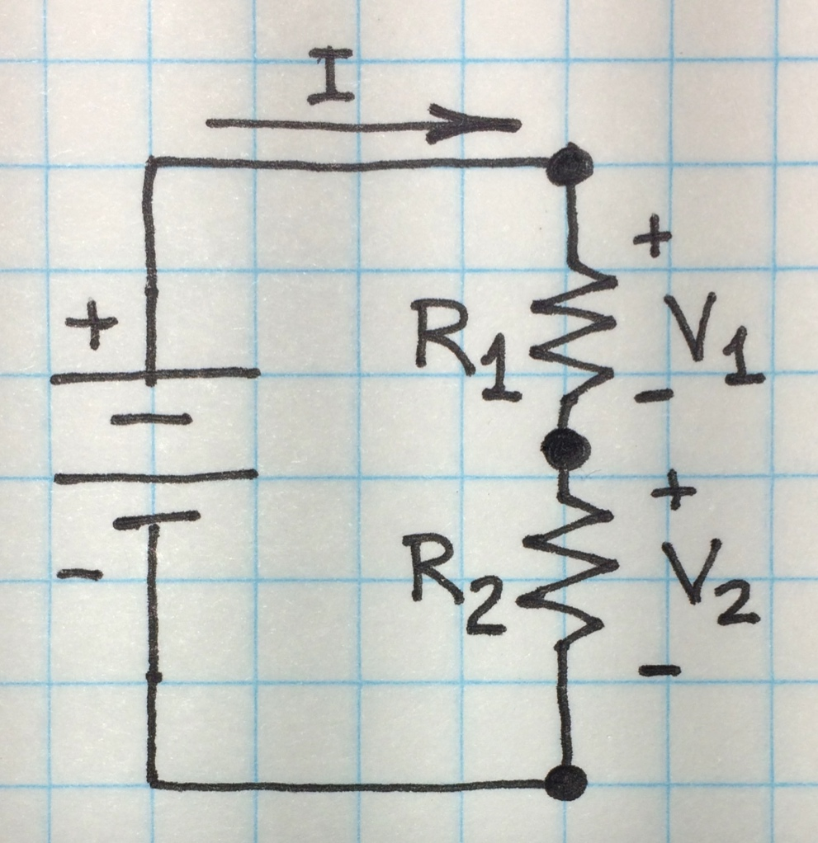
Example circuit with supply voltage V
By Kirchhoff’s Voltage Law V + V₁+ V₂ = 0 or V = V₁+ V₂
By Kirchhoff’s Current Law, I, must flow through resistors R₁ and R₂ equally
Ohm’s Law says voltage from Output to Ground I = V₂/R₂ and voltage from High to Ground I = V/(R₁+ R₂)
thus Output voltage V₂ is V₂= V(R₂/(R₁+ R₂))
High
V
Output
Ground

